Slide 1
Social Recommendation
YANG Chunfeng
yc012@ie.cuhk.edu.hk

Slide 2
Outline
Brief summary of social recommendation
Questions
Preliminary Ideas
Formulation

Slide 3
Outline
Brief summary of social recommendation
Questions
Preliminary Ideas
Formulation

Slide 4
Approaches
Collaborative Filtering(CF): user-based and item-based (including Matrix factorization(MF): latent feature space; Clustering CF)
Content-Based(CB)
Demographic recommendation
Association Rule
Social-filtering: Social/trust-based: social connection from real social network; artificial social network graph(graph-based).
The combination of the above approaches

Slide 5
challenges
Data Sparsity
cold start
Scalability
Synonymy
Gray Sheep
Shilling Attacks
personal privacy
Explainability
Increased noise

Slide 6
Social filtering
Users’ trustworthiness has been measured according to one of the following two criteria:
taste similarity (i.e., “I trust those who agree with me”),
social ties (i.e., “I trust my friends, and the people that my friends trust”).
The former criteria aims at identifying competent users, but is subject to abuse by malicious behaviors.
The latter aims at detecting well-intentioned users, but fails to capture the natural subjectivity of tastes

Slide 7
Data
Depend on the available specific data structure
User behaviors data: page views, click-thru, watch video, search log, favorite, vote/rating, share, review. (context: timestamp, location, mood; engagement) (red is for large size, blue is for middle size, purple is for small size; bold is for all users, italic is for registered user)

Slide 8
Metrics
Online: CTR
Offline:
Numerical(rating): MAE(mean average error(eliminate the impact of outlier/noise)); RMSE(root mean square error);
Binary: F-measure(precision(hit-ratio), recall)(fit for top-N recommendation)
Ranking: NDCG(normalized discounted cumulative gain); MAP(mean average precision)(refer to Netflix ppt)

Slide 9
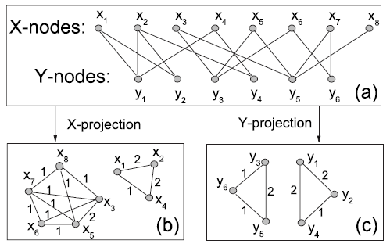
Social-based:
real social connections
artificial social network constructed from co-viewed/co-rated/co-tagged/co-reviewed graph
(Bipartite graph/Affiliation Network, such as user-item rating matrix, can be converted to such “social graph”(Markov network/Markov Random Fields)：Bipartite network projection(one-mode) )
Bipartite graph
Markov network(Markov random field)

Slide 10
Social connection + CF(user-based)
For a given user, the score for each video candidate composes of:
the interest degree of this video by the user’s friends
the relationship strengths between the user and his friends.
The final recommended videos are ranked according to the accumulated recommendation scores from different recommenders
relationship strength: Not only depend on the friendship or followship, but also calculated by user’s profile information, interaction activities and the activity domains
“On Video Recommendation over Social Network”, X Zhao, J Yuan, R Hong, M Wang, Z Li - Advances in Multimedia, 2012 – Springer. Citation:4

Slide 11
Markov network + RWR
Using co-rated and co-tagged information to construct social network graph.
Then using Random Walk with Restarts (RWR) to do recommendation.
“Graph-based Recommendation on Social Networks” Z Wang, Y Tan, M Zhang - Web Conference (APWEB), 2010. Citation: 11

Slide 12
Markov network + RW
Convert user-video graph to co-view graph
Using Random Walk Algorithm to do recommendation
“Video Suggestion and Discovery for YouTube Taking Random Walks Through the View Graph”. S Baluja, R Seth. 17th WWW, 2008. Citation:178

Slide 13
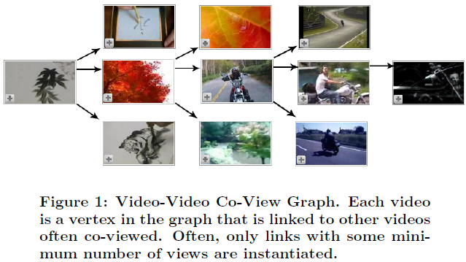
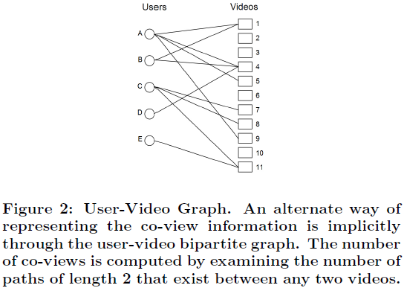
co-view graph
user-video graph

Slide 14
Random Walk with Restart (RWR)
The basic idea of RWR can be expressed as:
p(t+1) = (1-a)Sp(t) + aq .
each step can restart from x with a probability of a.
p(t) be a column vector where p(t) i denotes the probability that the random walk at step t is at node i.
q is a column vector of zeros with the element corresponding to the starting node set to 1, i.e. qx = 1.
a is the damping coefficient (to make personal judgement)
S is the transition probability matrix
Almost the same as Google topic-specific PageRank with random teleport

Slide 15
Random Walk with Restart (cont.)
If we want to recommend resources to user i, we will mark node i as the starting node.
q is a vector in which the element corresponding to the starting node is set to 1.
So it should be easily accessible to the node which is closer to the starting node that they would get greater stationary probabilities.
Therefore, after the iteration converges, we sort the nodes with their stationary probabilities. The node with larger stationary probability is closer to the target node

Slide 16
Markov network + CB
Using co-review information in IMDB dataset to construct a social network graph.
Then using this graph together the content-based approach(consider the content feature: actor, genre, rating, type, keyword, country, language, director, release year, vote, company)
to assign weights to each to these features to establish a model for recommendation
“Feature Weighting in Content Based Recommendation System Using Social Network Analysis” S Debnath, N Ganguly, 17th international conference WWW on 2008. Citation:92

Slide 17
Social connection + CF(item-based)
Social Network → Trust Network
TrustWalker ：Combines Item-based Recommendation and Trust-based Recommendation
With Φ_{u,i,k} , the random walk stops. Randomly select item j rated by u and return r_{u,j} (Φ_{u,i,k} = 1: pure item-based);
With 1- Φ_{u,i,k} , continue the random walk to a direct neighbor of u (Φ_{u,i,k} = 0: pure random-walk based/Trust-based).
where Φ_{u,i,k} is the probability of stopping the random walk at node u in step k.
“TrustWalker A Random Walk Model for Combining Trust-based and Item-based Recommendation” M Jamali, M Ester, 15th ACM SIGKDD,2009. Citation:178

Slide 18
Social-connection + MF
SocialMF：social propagation combined with matrix factorization(MF).
MF to obtain latent feature space.
can operate on any matrix related with Bipartite graph
latent feature of a user is affected by the latent features of his neighbors.
Calculate social-based latent features to do recommendation
“A matrix factorization Technique with Trust Propagation for Recommendation in Social Networks”, M Jamali, M Ester, fourth ACM conference on Recommender systems. Citation:109

Slide 19
Markov network + RW + Ranking
Construct co-viewed graph.
Using random walk to find candidate sets of a set of videos.
Ranking those candidate to decide the final recommendation.
Ranking process consider:
Video quality
User specificity
Diversification
“The YouTube Video Recommendation System”. J Davidson, B Liebald, J Liu, Recommender systems, 2010. Citation:93

Slide 20
Social activities + CB
Concern the social activities: video importing and re-sharing.
Target: recommend importing/re-sharing video list.
1. Using social connection to update part of the user-item matrix(deal with user cold-start).
2. Construct user space (with representatives such as the celebrities) and content space (with representatives that is different from other the most)
3. Combine user space & content space to do recommendation
“Joint Social and Content Recommendation for User-Generated Videos in Online Social Network”. Z Wang, L Sun, IEEE Transactions on Multimedia, 2013. Citation:3

Slide 21
Outline
Brief summary of social recommendation
Questions
Preliminary Ideas
Formulation

Slide 22
Questions
Whether to use social-based video recommendation to offline predict viewership (Precision/Recall) or online A/B test with social explanation(Click-Through-Rate).
How to make use of mobile-side data(what is the common user activities) for Tencent Microblog.
How to measure social videos, such as the video propagation pattern, video lifecycle, user behaviors/ activities. (The availability of data source)

Slide 23
Outline
Brief summary of social recommendation
Questions
Preliminary Ideas
Formulation

Slide 24
Ideas
Social-based video recommendation
Online test: Add social module for social explanation (CTR)
Offline test : Use history data to validate (F-score, such as recall for top-N recommendation to compare with test records)
Tencent Video (Both PC and mobile-side have not adopted social recommendation modules yet)
Utilize mobile-side data(user activities) for Tencent Weibo

Slide 25
What’s new
Most of previous work do not use the real social connections (instead, they use the artificial social network constructed from co-viewed/co-rated/co-tagged/co-reviewed graph)
Previous work has not implemented in real system to validate online(A/B testing).
In the case of Tencent, the social network and video website own many common users for convincing analysis.
Utilize mobile-side data & analyzing social activities

Slide 26
Ideas (cont.) -Social video measurement(Micro-UGC)
After the measurement of Tencent Weishi(social video), we can identify some specific user/social behaviors/activities (and the patterns).
With these observations, we can further apply to Social Video Recommendation in Social Network or Recommend Social Video to Video Website (previous work is social-based video recommendation in video website, or recommend video from video website to social network)
or obtain insights for socialized videos/ videolized social network(视频社交化/社交视频化).

Slide 27
Ideas (cont.) -Social video measurement
Reference
“Characterizing User Behavior in Online Social Networks”
“Measurement and Analysis of Online Social Networks”

Slide 28
Formulation
Combine many approaches: Social connection; artificial social network graph(through co-viewed/co-rated/co-tagged/co-reviewed records); Content-based(actor, director, release year, type, genre, keyword, country, language, company, etc.); Collaborative Filtering(+PMF).
Concerned issues: popularity, personalization (historical records for both signed users or unsigned users with cookies), relatedness (content-based), diversity

Slide 29
Popularity
Relatedness: the video being viewed
Personalization : every single video has its related video list. Then according to one user’s historical records(filtered with user preference (QoE/engagement)), obtain all the video lists to preserve for the final personal recommendation.
Socialization also reflect the personalization

Slide 30
Formulation (cont.)
Social network graph:
Social connection: user-based
Co-viewed/rated/tagged/reviewed social graph: item-based/user-based
Random Walk with Restart(RWR) to deal with social network graph (Personalized recommendation):
Graph-based clustering for social graph/spectral clustering(eigenvector, MST, Clustering coefficient)
Reference: “A Random Walk Method for Alleviating the Sparsity Problem in Collaborative Filtering”

Slide 31
Formulation (cont.)
Utilize mobile-side data(user activities) for Tencent Weibo
1.Measure existing user activities(interaction or concurrency) that can be tracked.
2.Based on these to create social features/social profile (together with user profile)for each user. Social features can infer the social relation/similarity of users
3.Using regression or other machine learning approaches to do feature selection and assign weights to the selected features
User similarity indication: # of co-viewed videos.
Do regression to obtain the weights of these social features:
#(1,2) = w1*d1(f1,1;f2,1)+w2*d2(f2,1;f2,2)+…+wn*dn(fn,1;fn,2)
where #(1,2) is # of co-viewed videos for user1,user2;
di is the distance measure for social feature i.
4.These weighted social features can be used to do social recommendation:
1).relationship strength to predict rating to weighted sum directly.(Like the paper)
2).Used in the markov network as edge weight to do RWR.
3). social profile + user profile → item profile → user-item similarity
Notes:
“On Video Recommendation over Social Network”

Slide 32
behavioral profiling model
0-th order models: binary event recorded only, for instance: the list of websites that were visited.
1-st order models: frequencies, probability distributions, for instance: a Bernoulli style model indicating the likelihood that a site will be visited, based on a frequency count of previous visits.
2-nd order models: causality relations, time-dependencies, for instance: a hidden-Markov style model, with transitional probabilities between site accesses.

Slide 33
New
Social feature/social profile(on social media/network)
combine 1st order model and 2nd order model
1st order model:
2nd order model: (Association Rule)
user-item matrix only reflect the 1st order model of user profile. Combined with records by association rule in video websites(2nd order) in order to obtain a complete user behavior model/profiling.
There is some association between demographic profile and User’s Browsing/viewing Behavior
Thus demographic information can be used for those who has few records for the user behavior model
Association-rule based video recommendation(not for video recommendation previously)

Slide 34
Formulation (cont.)
Content-based:
Model-based: use machine learning approach to do feature selection/model selection and use historical data to validate.
item profile → user profile → user-item similarity
item profile:
Feature selection (regarding the content itself) and feature weighting (using regression with co-rated,co-tagged,co-reviewed,co-viewed information) to obtain content/item features and their weights
Type-specific/dependent: doing such a process regarding different content features/feature weights for different type of videos (TV,movie,UGC)

Slide 35
Social feature(new), Collaborative feature, type-specific Content feature
combine social feature, content feature
“Recommendation as Classification Using Social and Content-Based Information in Recommendation”, C Basu, H Hirsh, AAI/IAAI, 1998. Citation:839

Slide 36
Thank you!

Slide 37
Collaborative filtering:
Matrix (with rows, columns as different objects) → Affiliation network(Bipartite Graph) → (Through one mode projection):Social Graph
For matrix: MF,SVD,PCA,LSH,CF
For social graph: RWR, PageRank,SNA
Content based:
user feature(collaborative feature, social feature), item feature,
Machine learning

Slide 38
In real video system:
recommendation(both prediction and system construction) needs to be related to time.(dynamic recommendation/freshness)
Temporal factor:
Freshness
Time issue in Association Rule
Dynamic system: for new users, new items, new activities(including ratings), user preference, item popularity.

